Slide 1

Vehicle Collision Detection
Made by:-
Atharva Mhaisekar 41141
Akash Kasat 41132
Akshay Khadse 41134
Hritik Mote 41142

Slide 2



INDEX - Problem Definition - Literature Review - Software Requirements Specification - Model & Design - Advancement in Technology - MPU 6050 Accelerometer - Evolution - UML diagram - Entity Relationship(ER) Diagram - Hardware Diagram - Software and Hardware used
z

Slide 3
In this current scenario, the usage of automobile increase with corresponding raise in population. Accordingly, the accident happens have also be increased due to distinct reasons. Among that, human mistakes while driving has become a crucial factor. There has been an increase of 32.4% in the total number of death rate caused by the road accidents during the year 2019. In addition, 20-50 million people were injured and disabled. This percentage has made an attention of many researchers to curb the accident growing rate, but since the that seems to be a little less practically applicable due to vast population. Therefore, a system needs to be created that will have a practical system which will reduce the chances of fatality to the lowest and will act as a post accidental plan.
Problem Definition
z

Slide 4
The system which is created by us deals with a motor vehicle collision detection system involving vehicles which sends information about the accident including the location and the time of the accident to mainly two places first aid center and the police station. This information is sent in the form of an alert message. But in the cases where there are no casualties a switch is provided which can be turned off by the driver to terminate sending the alert message. A GSM, also known as global system for mobile Communication, module is used to send an alert message and a GPS, The Global Positioning System, module is used to detect the location of the accident. The GPS and GSM module are interfaced to the control unit using serial communication. The accident itself is detected using a sensor- accelerometer, which actually detects a change in the velocity of the vehicle, in a range of given threshold, And hence detects the collision between two automobiles Simultaneously sending a signal through Arduino. A 32bit ARM controller is used as the main high-speed data-processing unit. The signals are sent from the Accelerometer sensor to the controller after passing through an amplifying circuit. The signal is then sent to our server which in turn Send it to the police station and hospital nearest to the accident location.
Literature Review
z

Slide 5
In this are users automobiles will be attached with an accelerometer which will detect the change in velocity of the vehicle and will send a signal to Arduino, The accelerometer will have a particular range that will determine the threshold of the sensor which will remove the exception cases like emergency brakes or stopping of a vehicle at a very low speed in limited amount of time For example the vehicle could be traveling at a speed of 40 kilometers per hour but when it has encountered a sudden break the accelerometer in that case, might detect it as an accident and may send a signal to the nearest police station and hospital which will be considered as a false alarm as the vehicle was not moving at an alarming speed that can cause an accident of severe level .
Software Requirements Specification
z

Slide 6
The signal which was triggered by the Arduino in the automobile will be received by our server and this server where also receive the GPS location of that particular automobile and will send the signal as well as the GPS location to the nearest police station and hospital. This server will be basically acting as an intermediate element between the user and the receiver, the server will be in receiving status 24 hours throughout the day at night.
z

Slide 7
The last phase of the system will be consisting of the sending of the signal which one receive through the Arduino present in the automobile and this signal will be then send to the nearest hospital and police station another part of this phase will be that the doctors present in The hospital will be able to access the medical reports and the medical histories hope that particular user who has been encountered with the accident. these medical reports and medical history will be present in a database system which is a part of the software and the user will have to upload their reports in their respective account which will be given as an option to the user, In a particular financial amount.
z

Slide 8
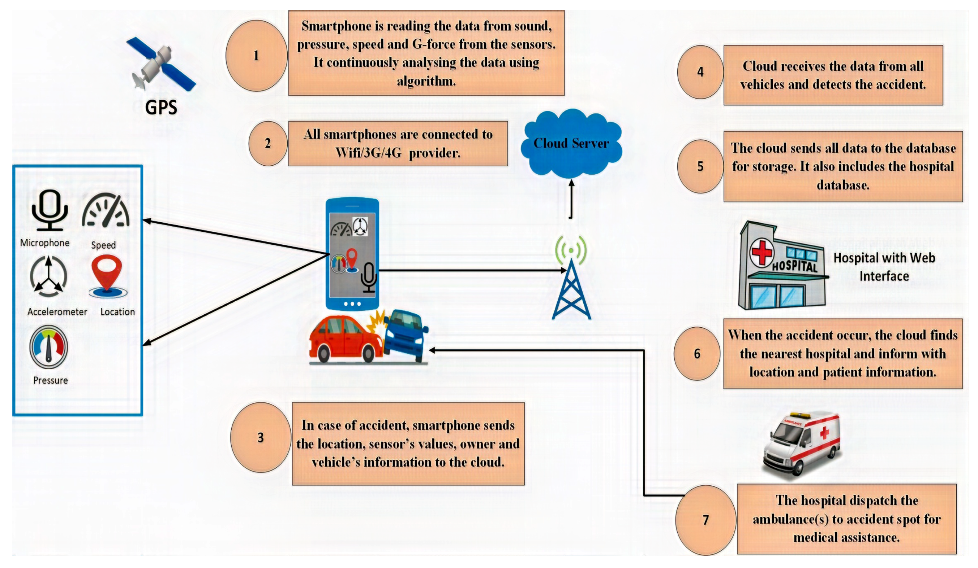
Model & Design
z

Slide 9
Accelerometer The accelerometer as the name suggests will measure the proper acceleration of the vehicle it does so by calculating the difference between the velocity off the vehicle all you can term it as the drop in the velocity of the vehicle or the rise in the velocity of the vehicle but in this project, we will be using accelerometer only two measure the drop in the velocity as well be detecting an accident which has taken place. Given below is an image of a MPU 6050
Advancement in Technology
z

Slide 10
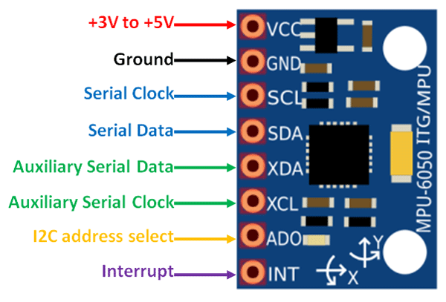
MPU 6050 Accelerometer
z

Slide 11

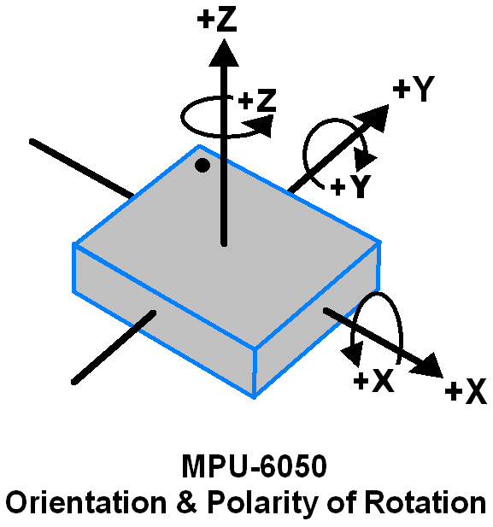
MPU6050 sensor module is complete 6-axis Motion Tracking Device. It combines 3-axis Gyroscope, 3-axis Accelerometer and Digital Motion Processor all in small package. Also, it has additional feature of on-chip Temperature sensor. It has I2C bus interface to communicate with the microcontrollers. The MPU6050 consist of 3-axis Gyroscope with Micro Electro Mechanical System(MEMS) technology. It is used to detect rotational velocity along the X, Y, Z axes as shown in below figure.
z

Slide 12
Engineering:-
Accelerometers can be used to measure vehicle acceleration. Accelerometers can be used to measure vibration on cars, machines, buildings, process control systems and safety installations. They can also be used to measure seismic activity, inclination, machine vibration, dynamic distance and speed with or without the influence of gravity.
Industry:-
Accelerometers are also used for machinery health monitoring to report the vibration and its changes in time of shafts at the bearings of rotating equipment such as turbines, pumps,^{[15]} fans,^{[16]} rollers,^{[17]} compressors,[18][19] or bearing fault[20] which, if not attended to promptly, can lead to costly repairs.
Evolution
z

Slide 13
Building and structural monitoring:-
Construction work – driving piles, demolition, drilling and excavating
Moving loads on bridges
Vehicle collisions
Impact loads – falling debris
Concussion loads – internal and external explosions
z

Slide 14
UML diagram
z

Slide 15
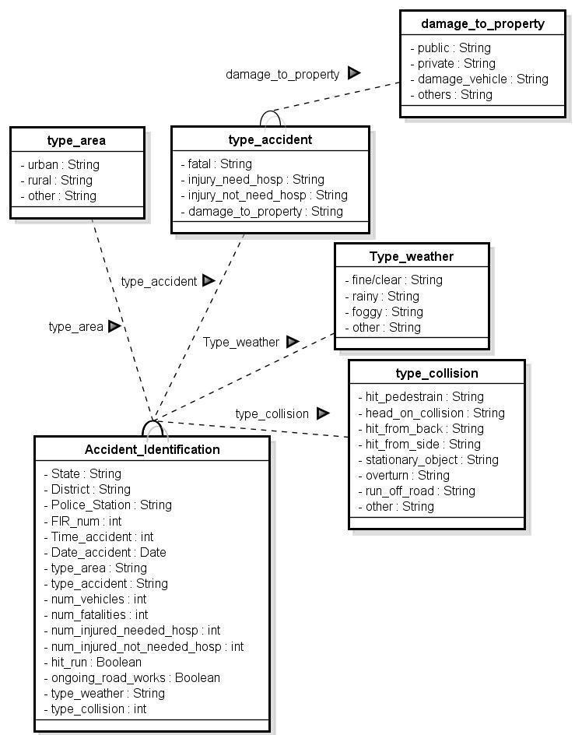
Specification and Features
UML class diagram demonstrate the structure of the system by depicting classes, attributes and relationship between them.
This UML is a simple and has a reusability property and also model can easily enhance, modify and updated according to the need of data
It indicates class diagram of accident information system having entities and operation of different attributes e.g. vehicle, accident, accident type, GIS, SMS, call, controller agent i.e. vehicle agent, region controller agent, city center agent & intersection controller agent etc. and road safety officer
This model gives us in-depth working agents of our systems and relationship between all the actors of systems
z
UML For Accident Identification

Slide 16
Entity Relationship(ER) Diagram
z

Slide 17
Specification and Features
These Entity relationship diagram are created in order to fulfill the requirements of road safety officers, the police, research groups, politicians and the member of Public.
It represents accident information system with safety & shortest path analysis diagram. This represents a subdivision of accident information system via vehicle owner which explains in two steps.
First steps indicate requesting for best route in terms of shortest path, cost etc. via registering location, vehicle & owner information to controller agent when an accident occurs. Controller agent broadcasts information to region control agent, city control agent and intersection control agent to find an optimum route by selecting that route.
The second step is to report an emergency in case of accidents via registering a complaint to the administrator by providing all information i.e. vehicle, road, weather, vehicle owner information etc. via SMS or call by requesting nearest hospital & police station. Administrator generates Road Traffic Control report and orders dispatcher toallocate

Slide 18
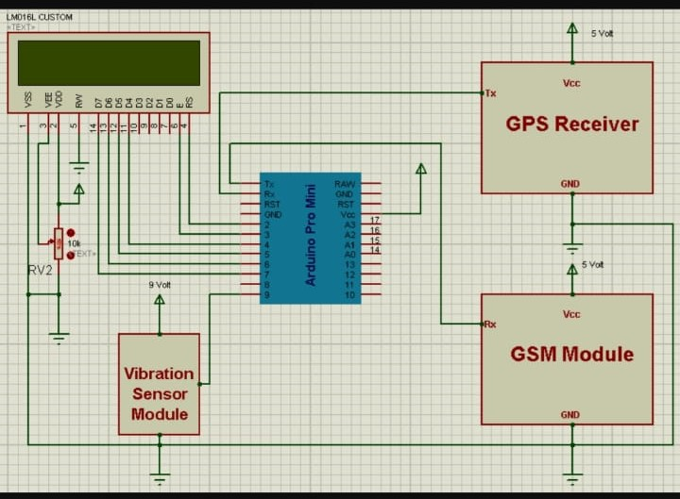
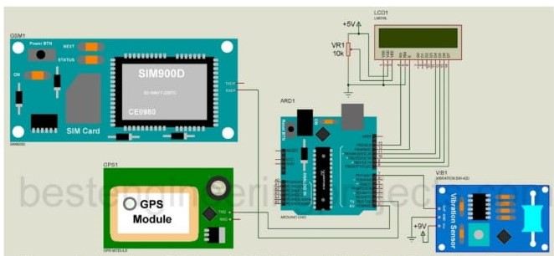
Hardware Diagram

Slide 19
1. Xampp software 2. MySQL 3. Python 4. PHP 5. Arduino IDE
Softwares Used
z

Slide 20
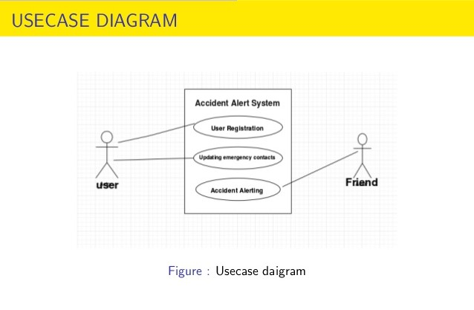
1. Arduino uno 2. MPU 6050 3. GPS Module 4. Bread board 5. Connecting cables
Hardwares Used
z

Slide 21

z

